Slide 1



A digital platform harmonising clinical care with research
Raising standards & building hope in MND
Judy Newton
Motor Neurone Disease Nurse Consultant

Slide 2
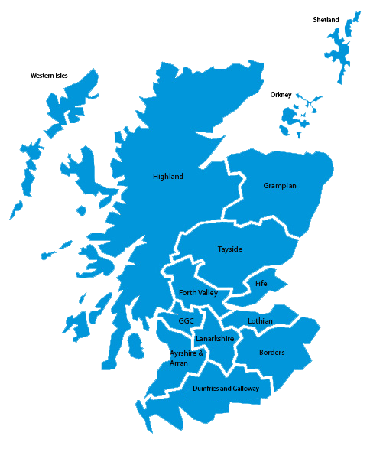

Scope of the problem in Scotland
5.3 million population
200 new cases per year
450 living with MND
14 health boards
5 major Universities
3 MND/ALS charities

Slide 3


2015- A unique investment in Scotland
Significant financial investment in MND
16 MND Clinical Specialists & 1 Nurse Consultant
National MND team are responsible for
Improving delivery of evidence based care
Education
Auditing NICE MND care standards
Increasing patient participation in research
Reducing admissions /increasing community led care

Slide 4
The history of change
1989
First MND Register in the world
2009
Scottish Neurological Standards of Care published
2014
Audit identified sporadic documentation and inequity of care
2015
First Minister announces £700k for MND Nursing
2017
CARE-MND launched
2016 Development of national MND Proforma and standardised assessment of patients

Slide 5
Clinical Audit Research Evaluation platform
digital /live platform
Every living patient has:
comprehensive capture of clinical information
clinical care benchmarked and audited against NICE MND Guidelines, 2016
Disease classification
Genetic analysis
Full capture of patient journey from diagnosis to death
the platform also acts as :
a research interest register supporting various observational and interventional studies
people diagnosed with MND in Scotland are invited to become registered for research studies
to accurately count the number of cases of MND in Scotland at any one time

Slide 6


https://www.care-mnd.org.uk

Slide 7
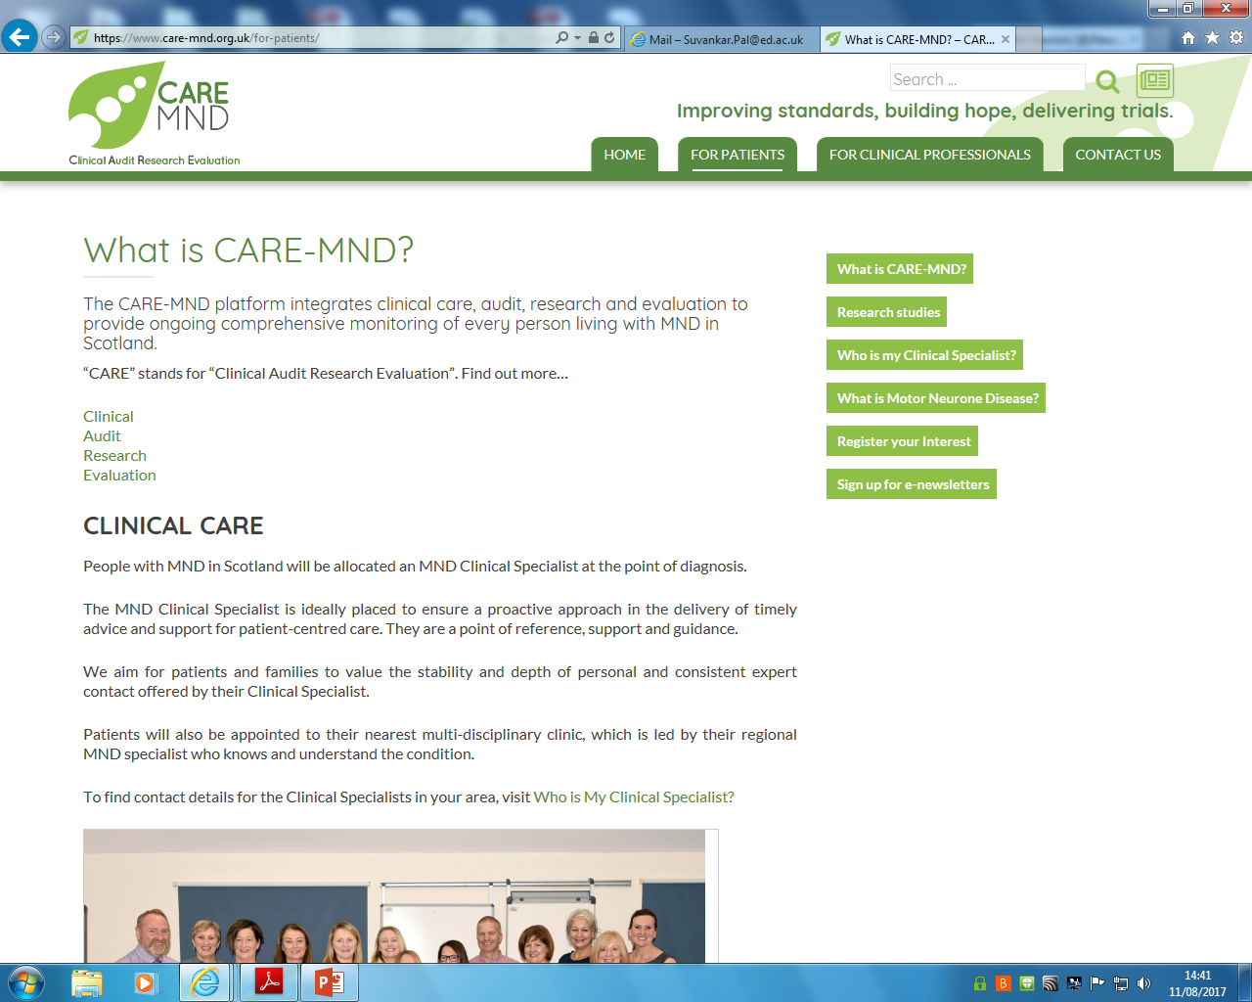
https://www.care-mnd.org.uk/

Slide 8
Clinical Care
Organisation of care
Cognitive assessment
Prognostic tools
Saliva management
Nutrition & Respiration
Augmentative and alternative communication
End of life care …

Slide 10
Audit
National led audits leading to publication
Comparative audits spanning 20 years
Local audits helping service provision

Slide 11
Audits carried out in 2017 based on KPI’s from NICE MND guidelines
A national audit gastrostomy insertion in MND
A national audit for planning end of life care in MND
National Audit of Riluzole prescribing in Scotland for MND
MND Environment
NHS Lothian A&E unexplained admission audit
National Cognition Audit
National Respiratory Audit

Slide 12
Research
Portfolio of +5 studies: cognition, DNA, observational and post-mortem
DNA capture on 85% of patients
Over 90% patients “research willing”
Linking of studies retrospectively
Accurate tracking of every patients involvement in research
Clinical trials

Slide 13
Evaluation
Annual reports to every health board
Local clinical care aligned to NICE with overall national comparison for benchmarking
Teams encouraged to request data for local audits

Slide 14

On behalf of the Scottish MND team have a great conference ! Thank you for listening

Slide 15

Thanks to
MND Steering Consortium
D Leighton
I Morrison
G Gorrie
S Abrahams
E Beswick
E Elliott
C Duncan
G Melichiorre
H Gordon
D Buchanan
J Preston
R Davenport
B Swingler
K Jayaprakash

